Slide 1
Branching Philosophy
Why do we branch the way we do?

Slide 2
Terms you should be familiar with
Git
Commits
Merging

Slide 3
What is branching?
Branches in GitHub are used to create a separate place where we can comfortably code to work on new features, fixes, or releases.

Slide 4
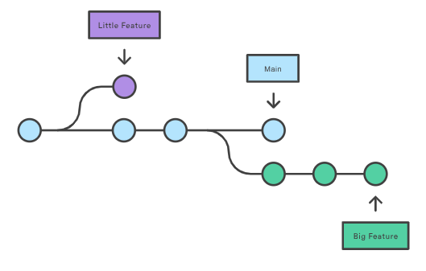

Slide 5
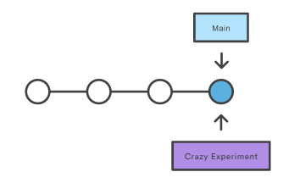
The repository history remains unchanged. You get a new pointer from there to branch off.

Slide 6
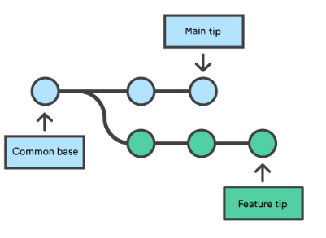
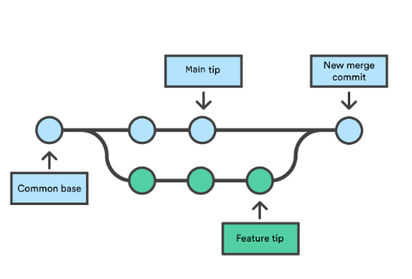
Merging Branches

Slide 7
Different workflows for branching
Centralized Workflow
Feature Branch Workflow
Our Workflow

Slide 8
Centralized Workflow
Developers start by cloning the central repository. In their own local copies of the project, they edit files and commit changes as they would with their code; however, these new commits are stored locally - they’re completely isolated from the central repository. This lets developers defer synchronizing upstream until they’re at a convenient break point.

Slide 9
Let’s take an example

Slide 10
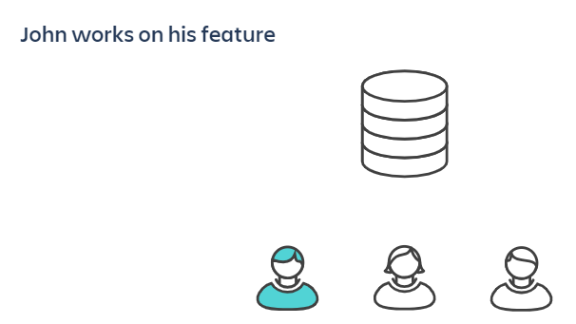

Slide 11
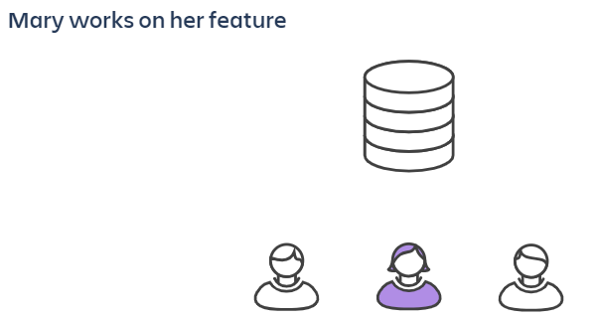

Slide 12
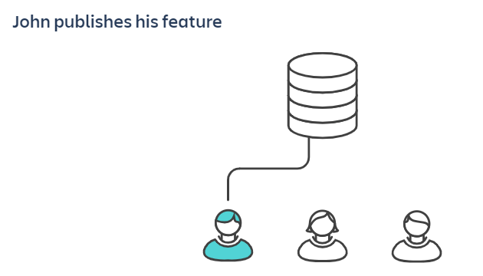

Slide 13
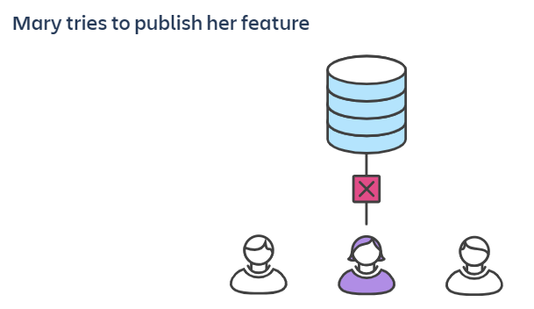

Slide 14
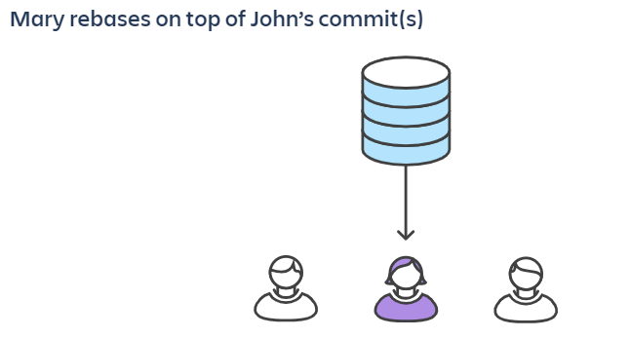

Slide 15
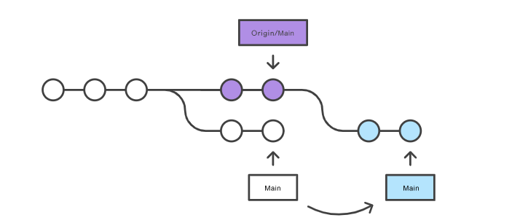

Slide 16
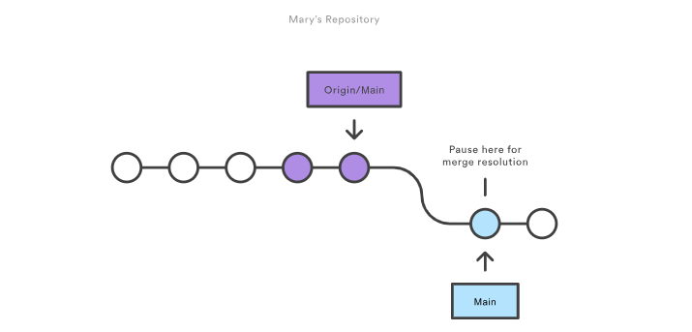

Slide 17
What are the downsides?
The issue is that two people cannot work at the same time.
This method is very prone to merge conflicts.
Anyone can commit to any branch, which might be live into production. (We will get back to this.)
Increases dependency on other teams.

Slide 18
2. Feature Branch Workflow
The core idea behind the Feature Branch Workflow is that all feature development should take place in a dedicated branch instead of the main branch.
This encapsulation makes it easy for multiple developers to work on a particular feature without disturbing the main codebase.
It also means the main branch will never contain broken code, which is a huge advantage for continuous integration environments.
They give other developers the opportunity to sign off on a feature before it gets integrated into the official project.

Slide 19
Let’s take an example

Slide 20
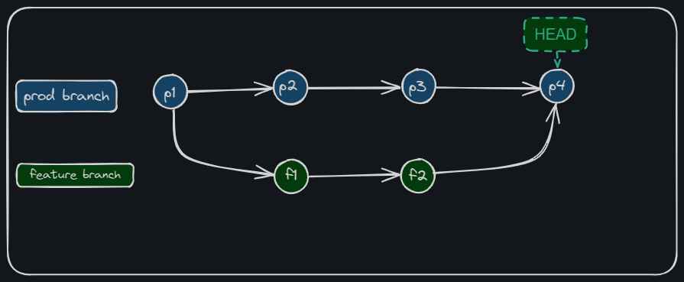

Slide 21
What are the downsides?
Does not accommodate for multiple environments.
Higher risk of multiple/duplicated merge conflicts.
Does not have the concept of release branches which means everything is pushed directly to production.

Slide 22
3. Our Workflow
Note: The diagrams have been simplified for illustrative purposes. Our real workflow will have two more environment branches. Do not worry about them for now.

Slide 23
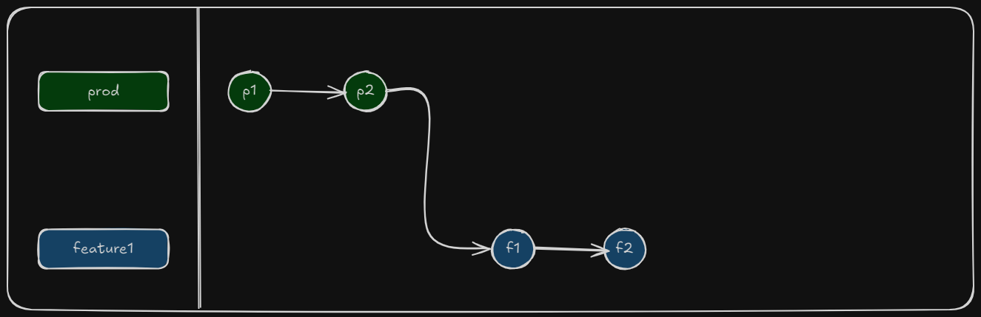

Slide 24
Say you want that feature in the dev branch

Slide 25
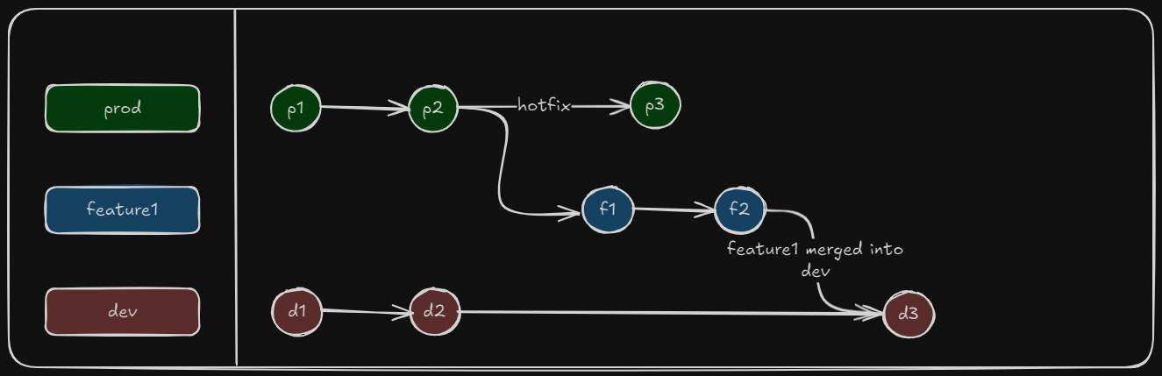

Slide 26
What if you wanted that feature in the prod branch?

Slide 27
We create a new branch named
release_{env_branch}_{feature_name}

Slide 28
And perform the same steps.

Slide 29
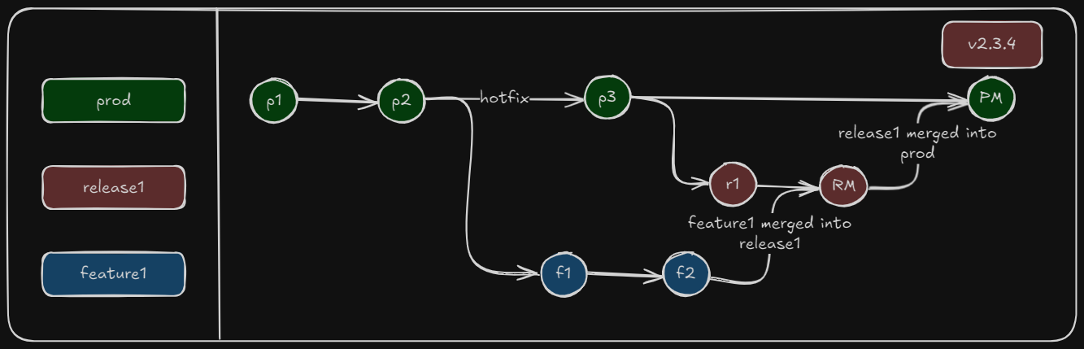

Slide 30
And tagging the release.
Notes:
Mention to the people, that there will be a separate training for Git Tagging

Slide 31
Recap
For all intents and purposes our master/main branch is called the production branch and will be referred to as prod
We will never make any commits or changes into an environment branch; prod, dev, alpha, beta.
When creating release branches, the naming convention would be, release_{env_branch}_{feature_name}
When rebasing and performing merges, it shall be done with pull requests. We will look into that in our next training.

Slide 32
Any Questions?

